Slide 1

MONTHLY PROGRAMMING
SOCIAL MEDIA BEST PRACTICES FOR ACCOUNTS

Slide 2
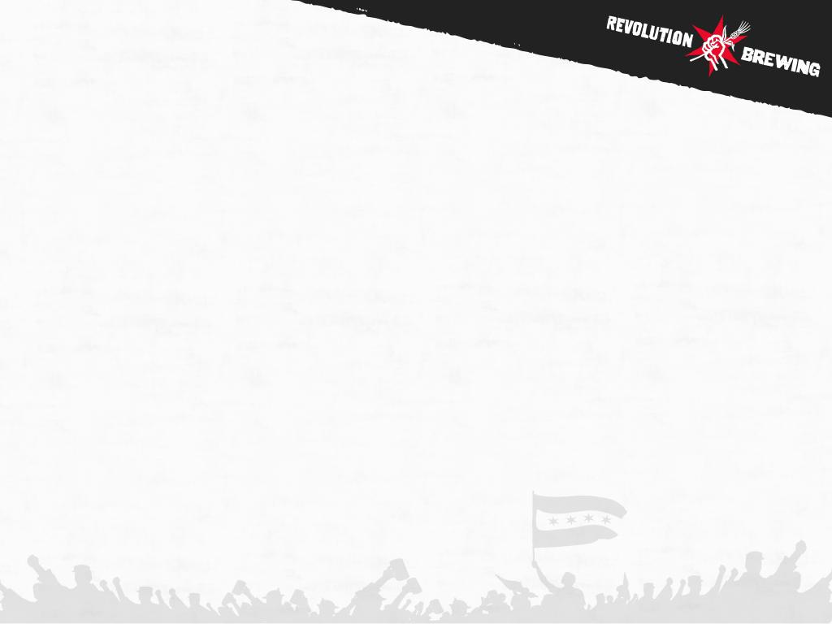

REVOLUTION BREWING SOCIAL CHANNELS & BRANDED HASHTAGS
Facebook: www.facebook.com/revbrewchicago
Tag us @RevBrewChicago
Instagram: @RevBrewChicago
Tag us in the copy and in the image
#RevolutionBrewing
#RevBrewChicago
#RevBrew
Twitter: @RevBrewChicago
Tag us in the copy and in the image
#RevolutionBrewing
#RevBrewChicago
#RevBrew

Slide 3
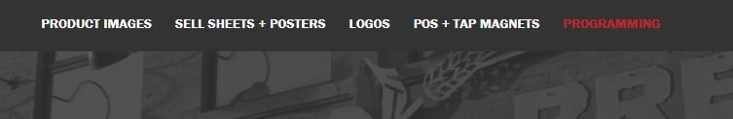
FACEBOOK THE ASK - CREATING YOUR BRANDED EVENT
Create a Facebook event
Directions on how to create a Facebook event can be found here
Use Facebook event cover graphic provided on our Graphic Assets Page:
Login Information:
https://revbrew.com/graphic-assets username: Guest password: rev-beer!
Click on the “Programming” tab to view graphics
Download the “Facebook Event Cover Photo”

Slide 4
FACEBOOK THE ASK - CREATING YOUR BRANDED EVENT (PART 2)
2. Event description:
Tag Revolution in the copy by typing @RevBrewChicago
Highlight featured Revolution beers
Time
Date
Any other important details of event
Example:
Join us on Thursday, July 26, as we team up with @RevBrewChicago to celebrate summertime and delicious beer. The evening will feature easy-drinking Rev brews and a Revolution raffle from 6-9pm. Raffle prizes include Revolution branded grills, coolers, chairs, towels, and other rad merch. Hope to see you there!
FEATURED REVOLUTION BEERS:
Freedom of Speach: a refreshing Session Sour with Peaches
Sun Crusher: a highly drinkable Hoppy Wheat Ale with flowery and citrus aromas

Slide 5
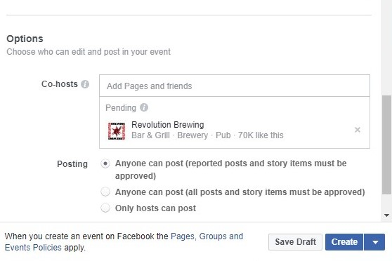
FACEBOOK THE ASK - CREATING YOUR BRANDED EVENT (PART 3)
3. Send Revolution Brewing a Co-host Request by scrolling down to the bottom while creating event and typing Revolution Brewing in the “Co-hosts” section
*Be sure to click on the Revolution Brewing that has 70k likes NOT the Revolution Tap Room or Brewpub location*
4. Post updates in the Facebook event in the days leading up to the event so that Facebook users who RSVP “Going” will receive reminder notifications

Slide 6
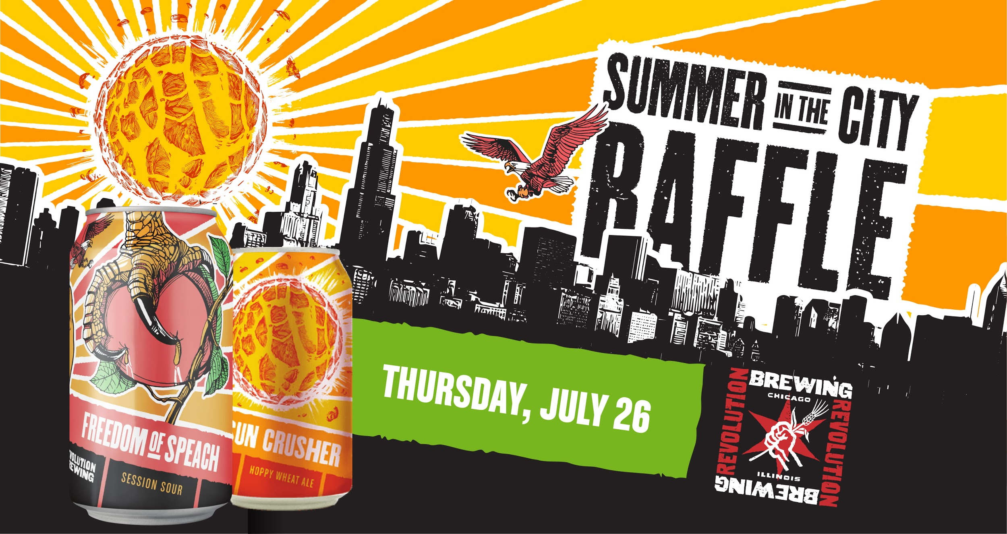
TWITTER THE ASK - EVENT PROMOTION
Tag @RevBrewChicago in the copy
Link out to the Facebook event
Attach Facebook event cover photo
Highlight time, date, featured Rev brews, & any other important details
Use applicable hashtags (#revbrew #revolutionbrewing #revbrewchicago)
Share on Twitter 2-3 times before event
Example:
Join us on 7/26 as we team up with @RevBrewChicago to celebrate summertime and delicious beer. The evening will feature Revolution's easy-drinking Freedom of Speach & Sun Crusher as well as a Revolution raffle from 6-9pm. Details: [Facebook link]. #revbrewchicago #revbrew

Slide 7
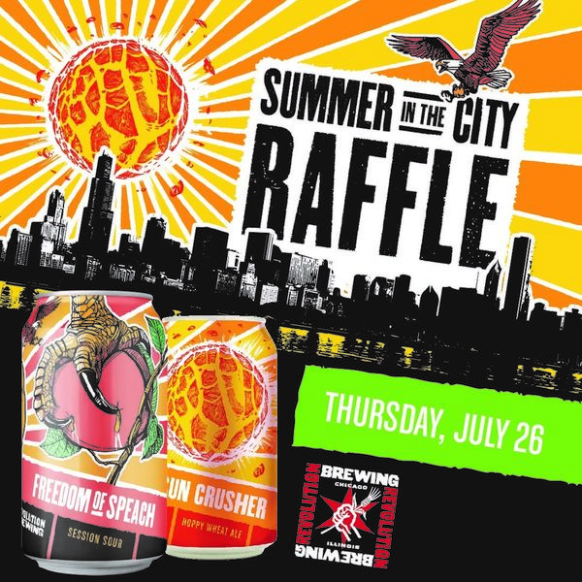
INSTAGRAM THE ASK - EVENT PROMOTION
Download Instagram image off of Revolution’s Graphic Assets Page
Tag @RevBrewChicago in the copy
Tag @RevBrewChicago in the photo by tapping on the photo before sharing and type @RevBrewChicago
Highlight time, date, featured Rev brews, & any other important details
Use applicable hashtags (#revbrew #revolutionbrewing #revbrewchicago)
Link to Facebook event in Instagram Profile’s bio
Share on Instagram at least once before event
Example: Join us on Thursday, July 26, as we team up with @RevBrewChicago to celebrate summertime and delicious beer. The evening will feature Revolution's easy-drinking Freedom of Speach & Sun Crusher as well as a Revolution raffle from 6-9pm. Details in the link in our bio. #revbrew #revolutionbrewing #revbrewchicago

Slide 8
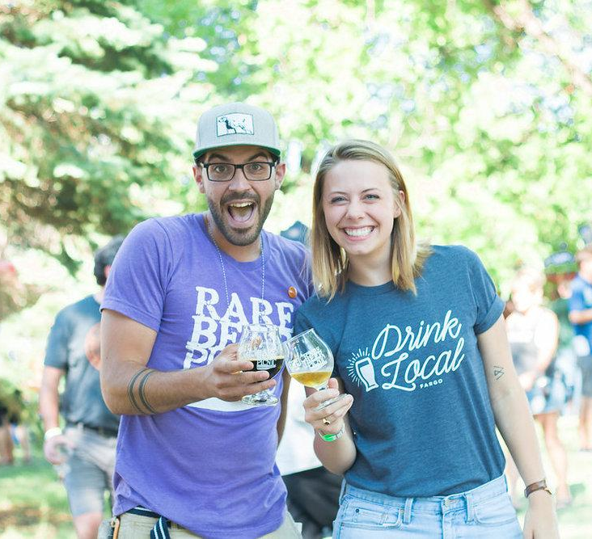
EVENT COVERAGE DURING EVENT PHOTOS
Photos of cans should focus on the brand specific logo, not the fist
Photos of pint glasses should focus on Revolution square logo
If attendees are in the photo, please ensure that everyone looks to be indulging responsibly and over the age of 21
Make sure photos are well lit and in focus
Avoid any other brand logos in the background

